Slide 1


Prototype driven development with Rails
Demo of employee/competence web-app for Danish Agency for Commerce and Companies
Jesper Rønn-Jensen
2006-06-01
reboot8

Slide 2
Me
Jesper Rønn-Jensen

Slide 3

Me
Capgemini Denmark

Slide 4
Me
Web development
& Usability

Slide 5
My Weblog
Justaddwater.dk

Slide 6
My Weblog
Justaddwater.dk
Feedback, please!

Slide 7
Capgemini

Slide 8
Capgemini
60,000 employees

Slide 9
Our core competences
Large projects

Slide 10
Our core competences
Collaboration

Slide 11
Our core competences
Specifications

Slide 12
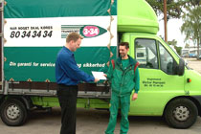
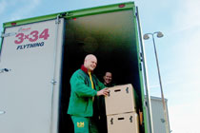
Our core competences

Slide 13
We also do
We also do
Small projects

Slide 14
Rapid prototyping
Prototype driven

Slide 15
User interface
Everybody understands

Slide 16

Rapid prototyping
Ruby on Rails

Slide 17
Case
Example

Slide 18
Danish Commerce and Companies Agency
Core need

Slide 19
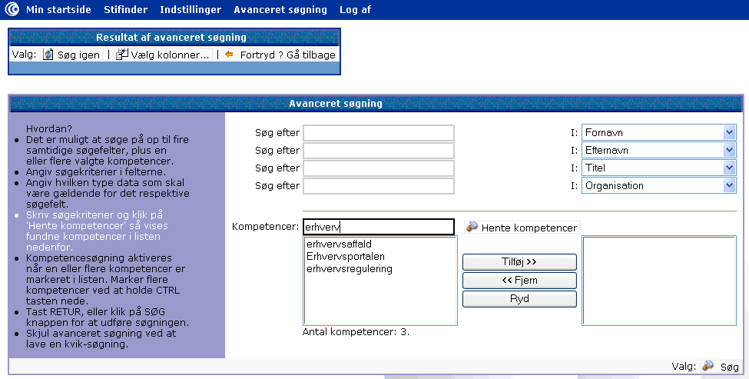
Legacy phone system

Slide 20
Process
Process
Notes:
small team
whiteboard
small sketches
20 hours

Slide 21
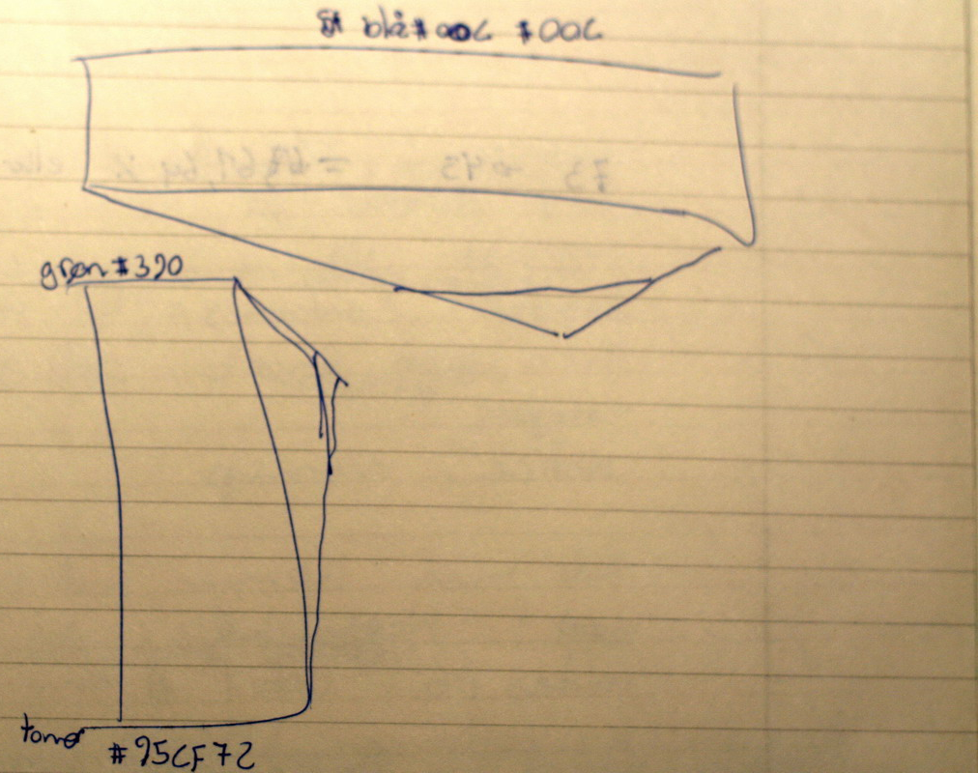
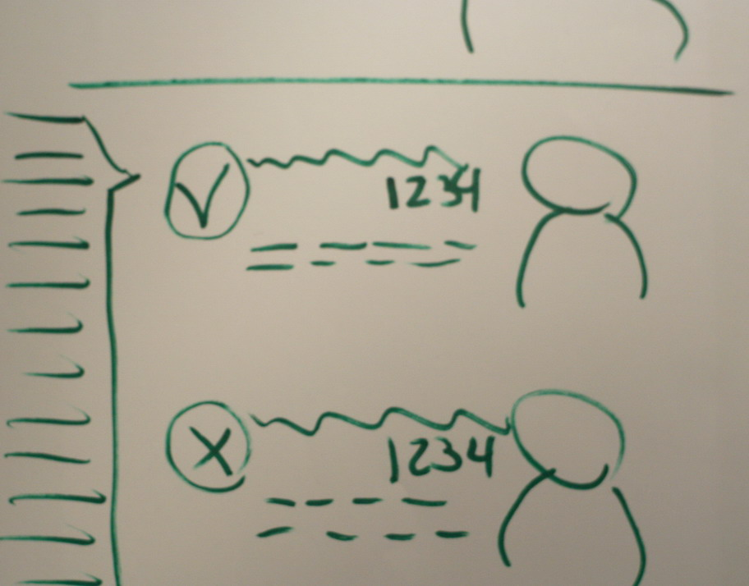
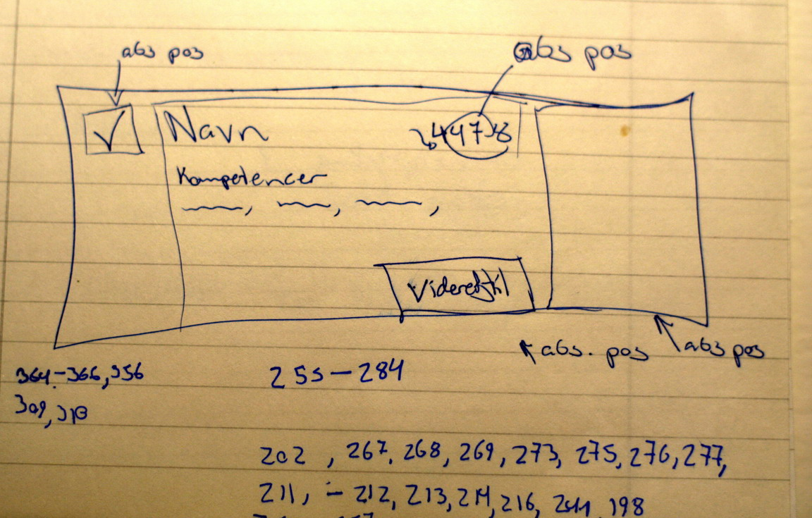
Process
Notes:
small team
whiteboard
small sketches
20 hours

Slide 22
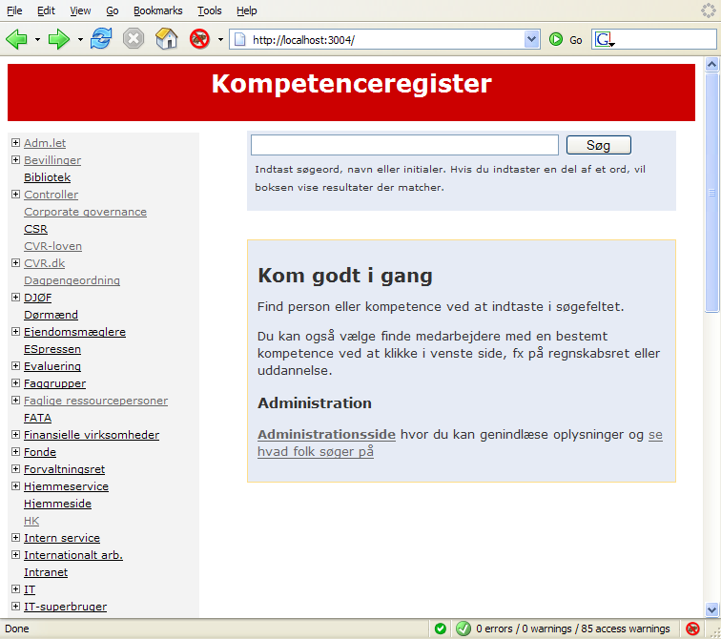
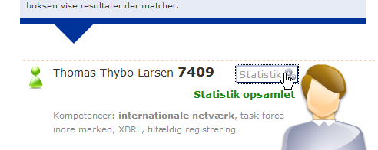
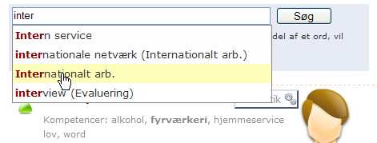
Demo

Slide 23
Conclusions
Fast and efficient

Slide 24
Conclusions
Collaboration

Slide 25
Conclusions
Precise

Slide 26
Conclusions
Added value

Slide 27
Conclusions
Real world usage
afterwards

Slide 28

Thanks!
This presentation at justaddwater.dk

